Slide 1
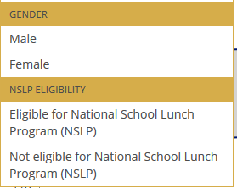
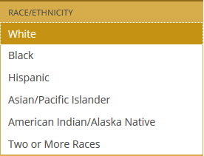
Achievement Gaps
1. Select jurisdiction
2. See the score for one student group
minus
3. Another student group
Jurisdiction
Student group 1
Student group 2
Grade 4 Grade 8 Grade 12
Subject 1
Check box to remove gap you no longer wish to see
White — Black
4. Dig deeper by adding a cross-tab
White male – Black male
White female – Black female
White — Hispanic
Male — Female
Key

Slide 2
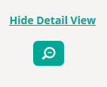
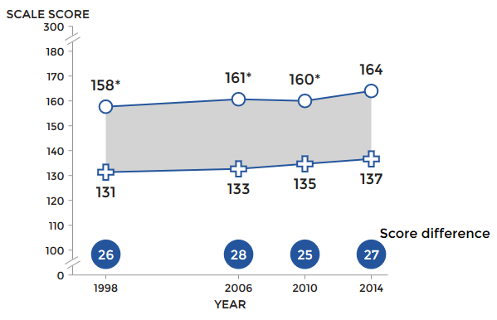
Achievement Gaps
1. Select jurisdiction
2. See the score for one student group
minus
3. Another student group
Jurisdiction
Student group 1
Student group 2
Grade 4 Grade 8 Grade 12
Subject 1
White — Black
White — Hispanic
Male — Female
Key

